Slide 1
Graph and Shortest Paths
Algorithms & Data Structures
ITCS 6114/8114
Dr. Dewan Tanvir Ahmed
Department of Computer Science
University of North Carolina at Charlotte

Slide 2
Shortest Paths
0
8
A
4
2
8
7
2
1
3
B
C
D
5
3
9
8
2
E
F
5

Slide 3
Outline and Reading
Graph Facts
Weighted graphs (§7.1)
Shortest path problem
Shortest path properties
Dijkstra’s algorithm (§7.1.1)
Algorithm
Edge relaxation
The Bellman-Ford algorithm (§7.1.2)
Shortest paths in dags (§7.1.3)
All-pairs shortest paths (§7.2.1)

Slide 4
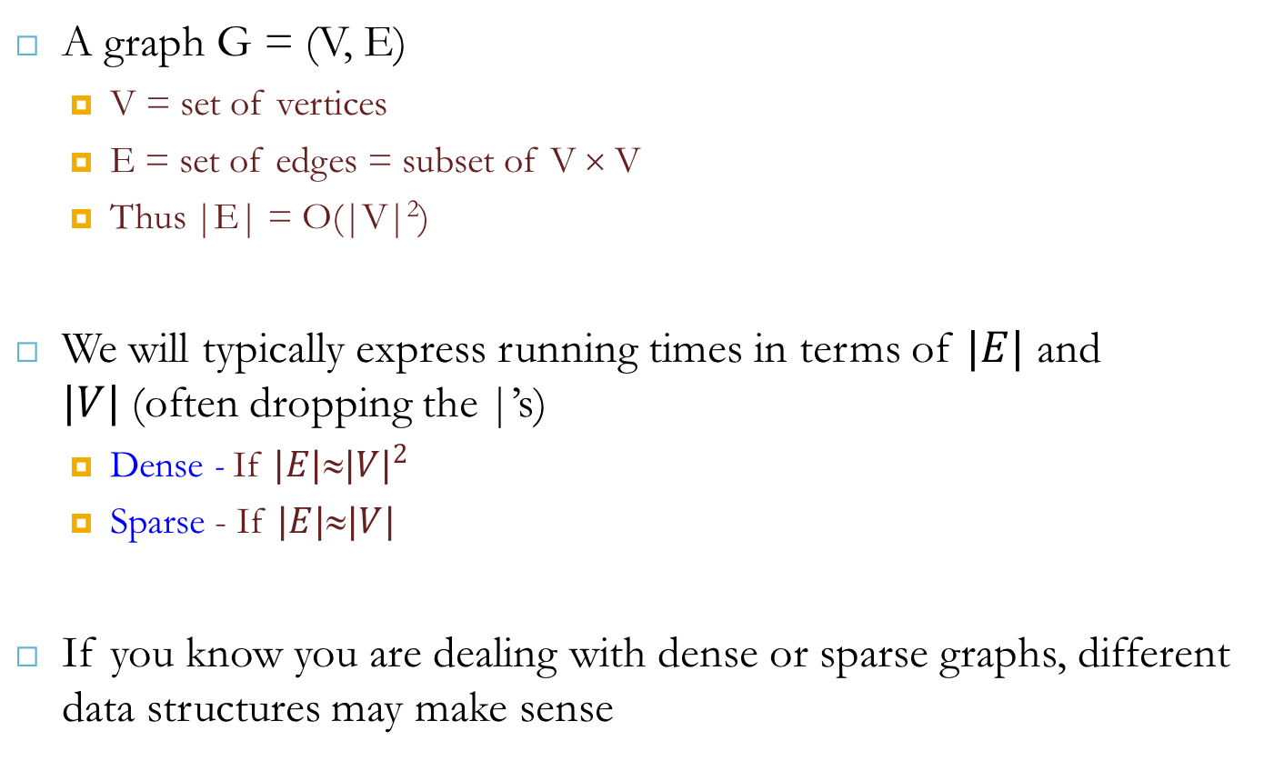
Graphs
A graph G = (V, E)
V = set of vertices
E = set of edges = subset of V × V
Thus |E| = O(|V|²)
We will typically express running times in terms of $|E|$ and $|V|$(often dropping the |’s)
Dense - If $|E|\text{≈}{|V|}^{2}$
Sparse - If $|E|\text{≈}|V|$
If you know you are dealing with dense or sparse graphs, different data structures may make sense

Slide 5
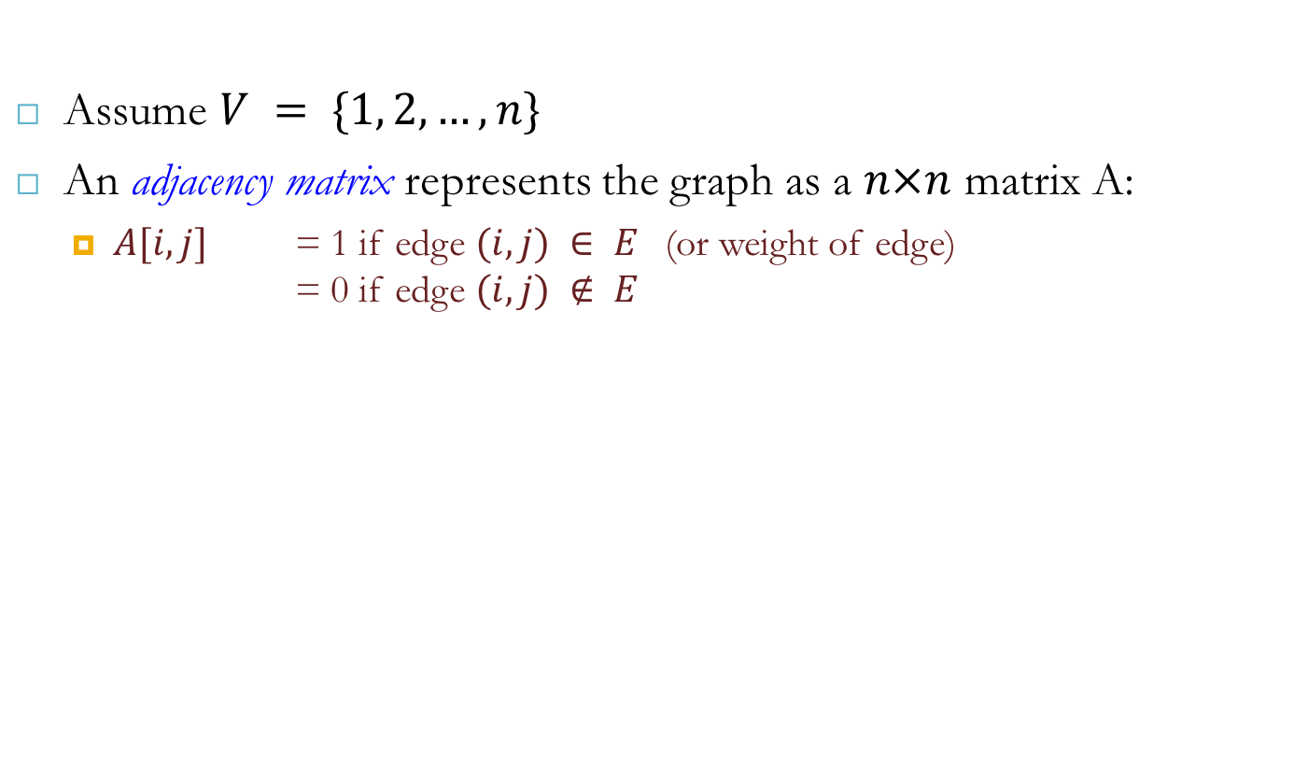
Representing Graphs
Assume $V = \{1, 2, …, n\}$
An adjacency matrix represents the graph as a $n×n$ matrix A:
$A[i, j]$ = 1 if edge $(i, j) ∈ E$(or weight of edge) = 0 if edge $(i, j) ∉ E$
A | 1 | 2 | 3 | 4
1
2
3
4
1
a
2
d
4
b
c
3

Slide 6
Graphs: Adjacency Matrix
Example:
A | 1 | 2 | 3 | 4
1 | 0 | 1 | 1 | 0
2 | 0 | 0 | 1 | 0
3 | 0 | 0 | 0 | 0
4 | 0 | 0 | 1 | 0
1
a
2
d
4
b
c
3

Slide 7
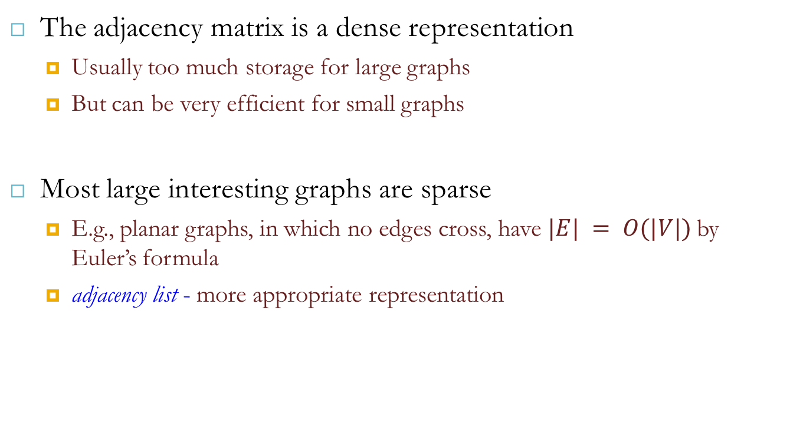
Graphs: Adjacency Matrix
The adjacency matrix is a dense representation
Usually too much storage for large graphs
But can be very efficient for small graphs
Most large interesting graphs are sparse
E.g., planar graphs, in which no edges cross, have $|E| = O(|V|)$by Euler’s formula
adjacency list - more appropriate representation

Slide 8
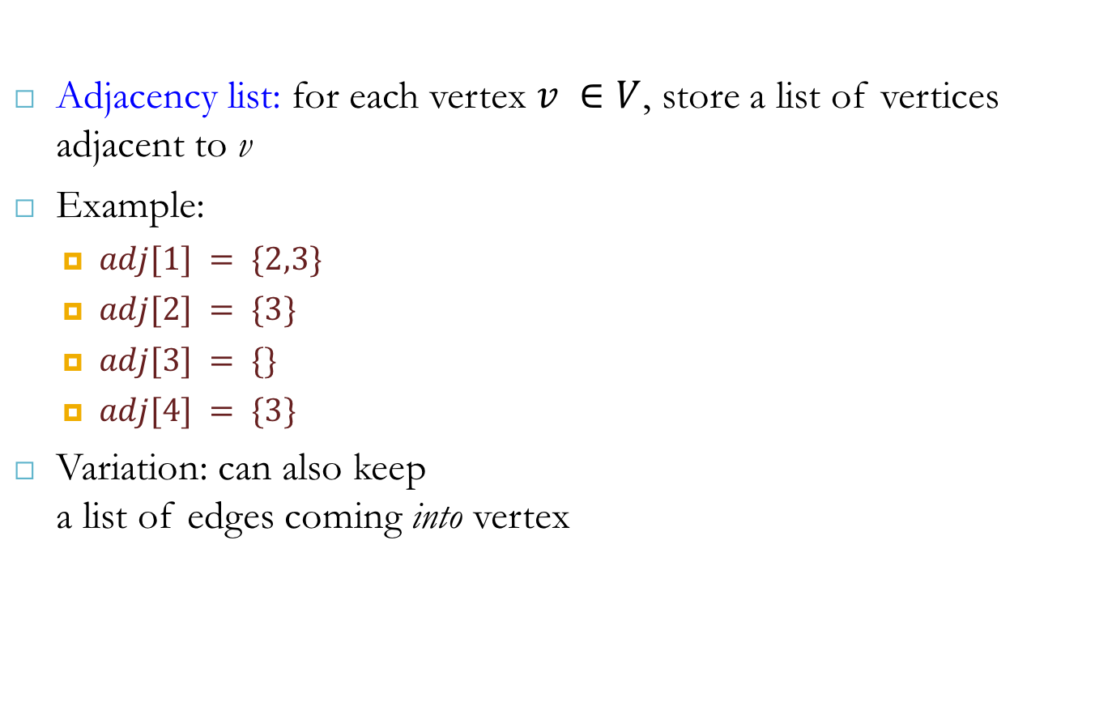
Graphs: Adjacency List
Adjacency list: for each vertex $v ∈V$, store a list of vertices adjacent to v
Example:
$adj[1] = \{2,3\}$
$adj[2] = \{3\}$
$adj[3] = \{\}$
$adj[4] = \{3\}$
Variation: can also keep a list of edges coming into vertex
1
a
2
d
4
b
c
3

Slide 9
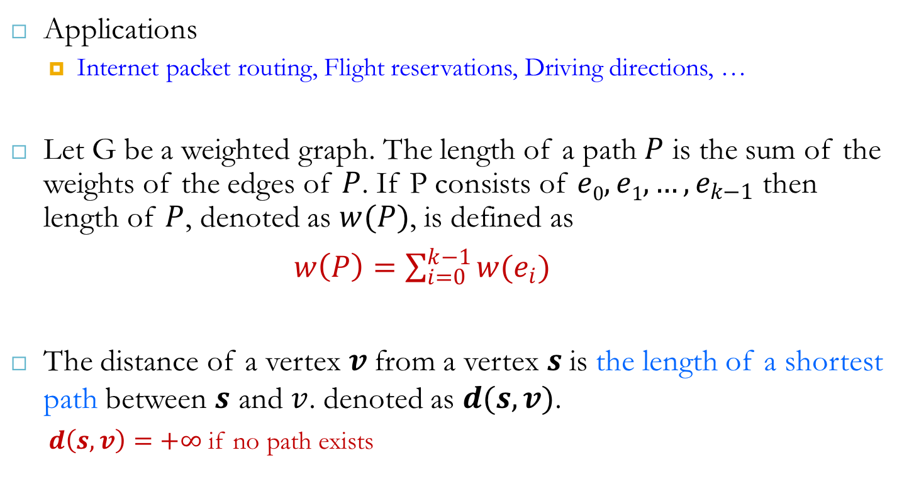
Single Source Shortest Paths
Applications
Internet packet routing, Flight reservations, Driving directions, …
Let G be a weighted graph. The length of a path $P$ is the sum of the weights of the edges of $P$. If P consists of $e0, e1,…, e_{k−1}$ then length of $P$, denoted as $w(P)$, is defined as
$w\left(P\right)=\sum_{i=0}^{k−1}{w(e_{i})}$
The distance of a vertex $v$from a vertex $s$is the length of a shortest path between $s$ and $v$. denoted as $d(s,v)$.
$d\left(s,v\right)=+∞$ if no path exists

Slide 10

Single Source Shortest Paths
Dijkstra’s algorithm:
It computes the shortes distances of all the vertices from a given start vertex $s$
Assumptions:
graph is connected
edges are directed/undirected
edge weights are nonnegative, i.e. $w(e)≥0$

Slide 11
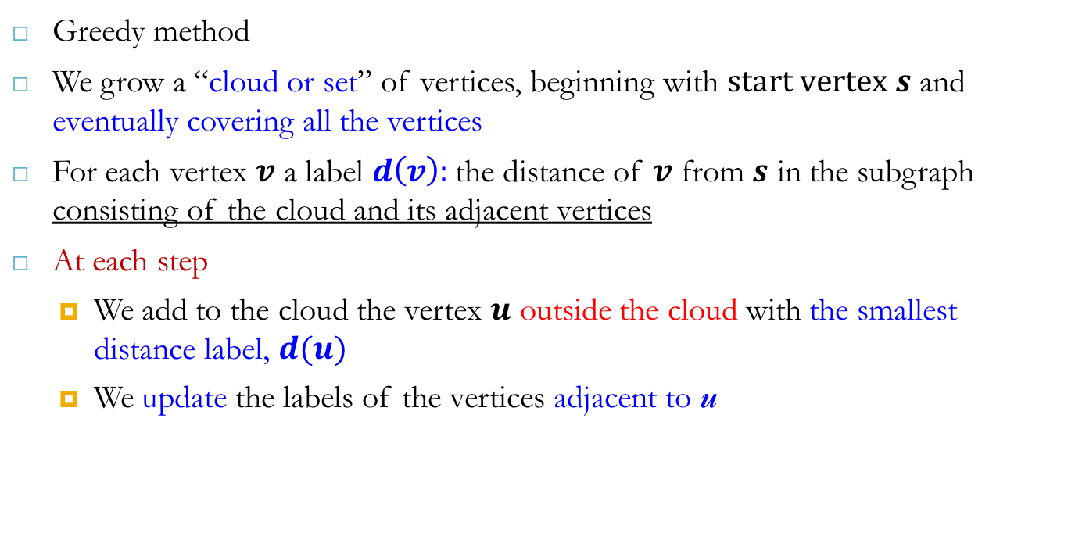
Dijkstra’s Algorithm
Greedy method
We grow a “cloud or set” of vertices, beginning with $start vertex s$ and eventually covering all the vertices
For each vertex $v$ a label $d\left(v\right):$the distance of $v$ from $s$ in the subgraph consisting of the cloud and its adjacent vertices
At each step
We add to the cloud the vertex $u$ outside the cloud with the smallest distance label, $d(u)$
We update the labels of the vertices adjacent to u

Slide 12
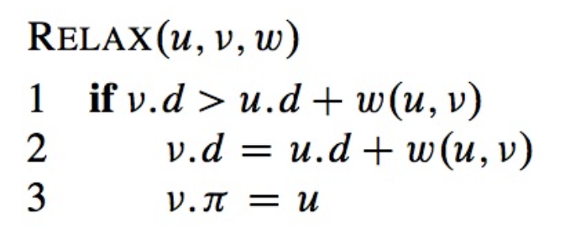

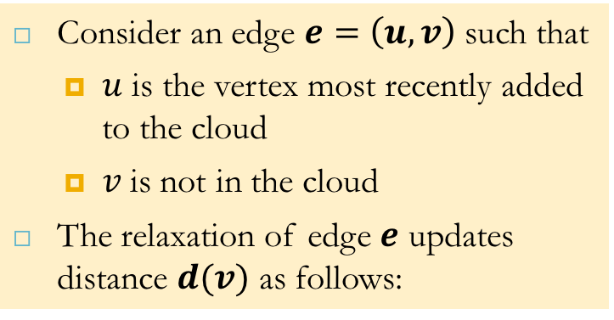



Edge Relaxation
Consider an edge $e=\left(u,v\right)$ such that
$u$ is the vertex most recently added to the cloud
$v$is not in the cloud
The relaxation of edge $e$ updates distance $d(v)$ as follows:
$$d(u) = 50$$
10
$$d\left(v\right)=75$$
u
e
s
v
$$d(u) = 50$$
10
$$d(v)=60$$
u
e
s
v

Slide 13
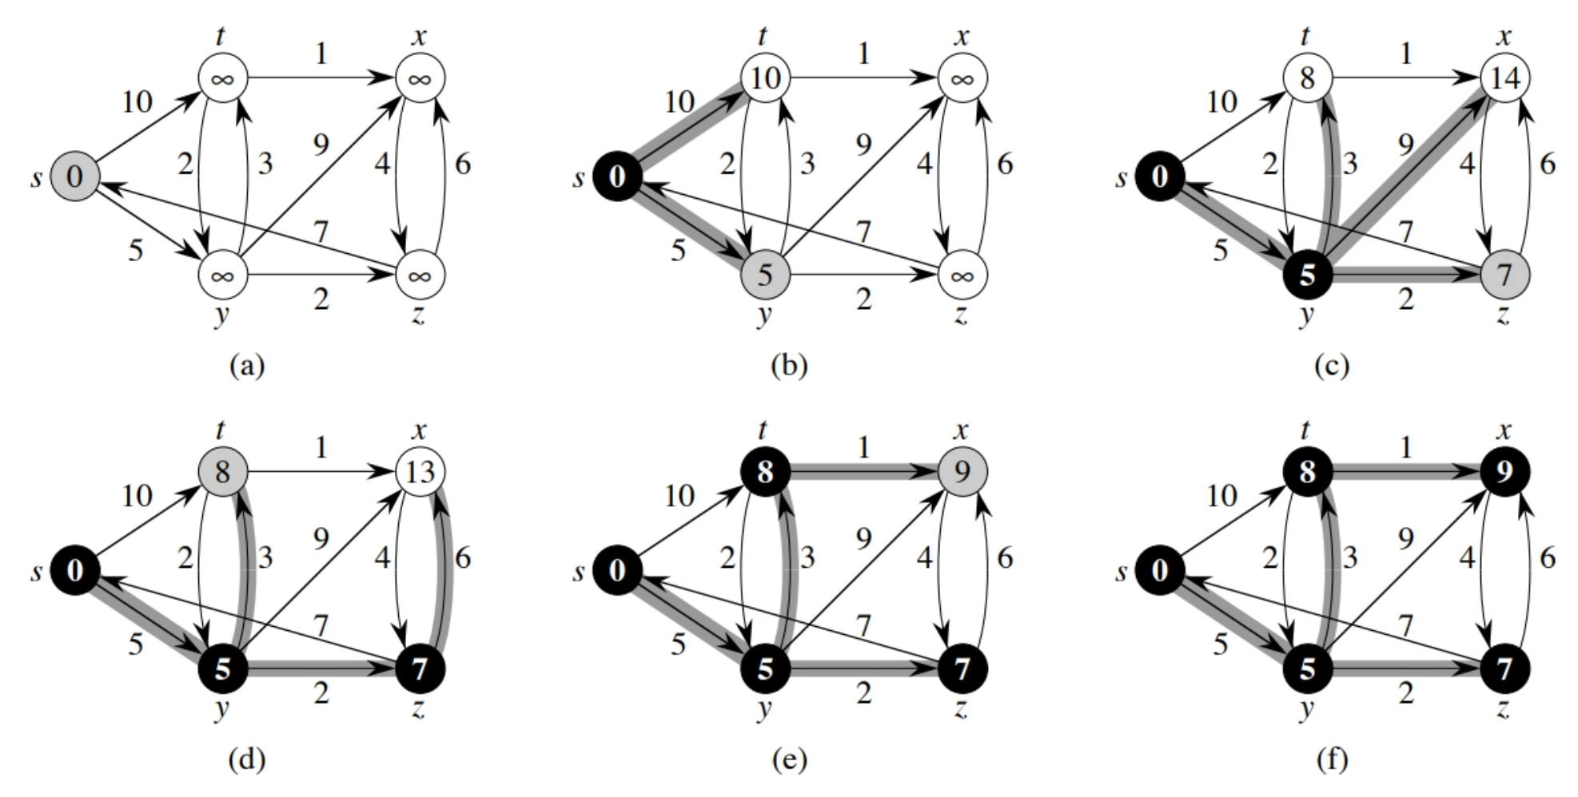
Example 1

Slide 14
Example 2
0
0
8
A
4
8
A
4
2
2
8
7
2
1
4
8
7
2
1
3
B
C
D
B
C
D
∞
3
9
∞
5
3
9
8
2
E
F
5
2
E
F
5
0
0
8
A
4
8
A
4
2
2
8
7
2
1
3
7
7
2
1
3
B
C
D
B
C
D
5
3
9
11
5
3
9
8
2
E
F
5
2
E
F
5

Slide 15
Example 2 (cont.)
0
8
A
4
2
7
7
2
1
3
0
B
C
D
8
A
4
3
9
2
5
8
7
2
3
2
5
B
7
C
1
D
E
F
5
3
9
8
2
E
F
5
0
8
A
4
2
7
7
2
1
3
B
C
D
5
3
9
8
2
E
F
5

Slide 16
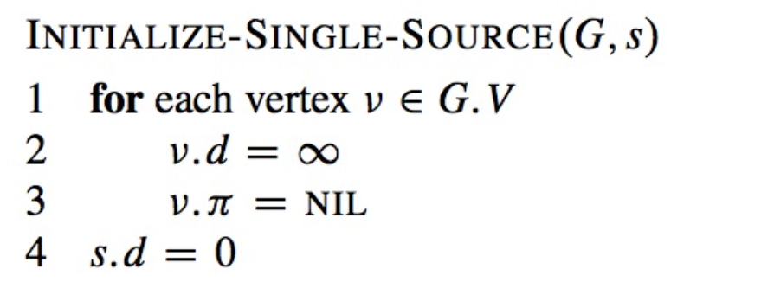
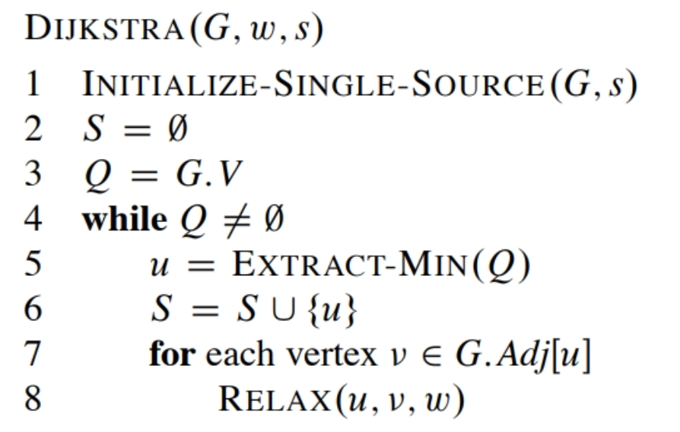
Dijkstra’s Algorithm and Runtime
What will be the total running time?
O(m lgn) using binary heap for Q
ExtractMin() - How many times called?
decraseKey() - How many times called?

Slide 17
Dijkstra’s Algorithm and Runtime
Each EXTRACT-MIN operation then takes time O (lgV).
The time to build the binary min-heap is O(VlgV)
Each DECREASE-KEY operation takes time O(lgV), and there are still at most O(E) such operations.
The total running time is therefore O( (V+E) lgV), which is O(ElgV) if all vertices are reachable from the source.

Slide 18
Shortest-path Tree
We can extend Dijkstra’s algorithm to return a tree of shortest paths from the start vertex to all other vertices
Store for each vertex a third label:
parent edge in the shortest path tree
In the edge relaxation step - update the parent label

Slide 19
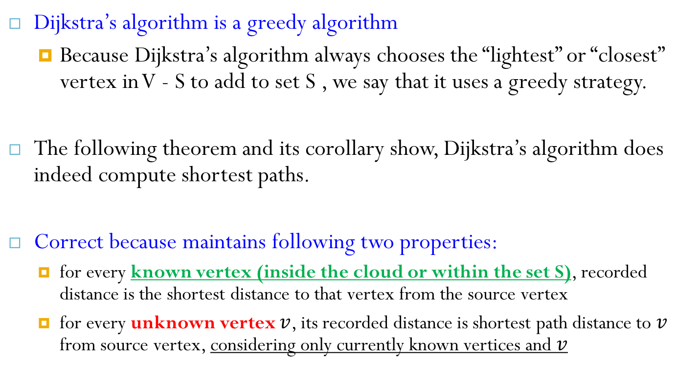
Correctness
Dijkstra’s algorithm is a greedy algorithm
Because Dijkstra’s algorithm always chooses the “lightest” or “closest” vertex in V - S to add to set S , we say that it uses a greedy strategy.
The following theorem and its corollary show, Dijkstra’s algorithm does indeed compute shortest paths.
Correct because maintains following two properties:
for every known vertex (inside the cloud or within the set S), recorded distance is the shortest distance to that vertex from the source vertex
for every unknown vertex $v$, its recorded distance is shortest path distance to $v$ from source vertex, considering only currently known vertices and $v$

Slide 20
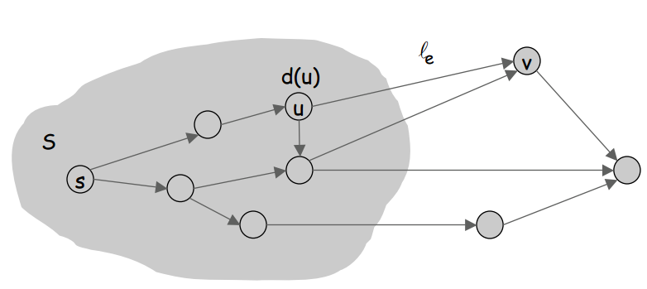

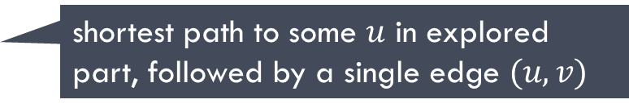
Dijkstra's Algorithm: Proof of Correctness
Dijkstra's algorithm:
Maintain a set of explored nodes $S$for which we have determined the shortest path distance $d(u$) from $s$ to $u$.
Initialize $S=\{s\}, d(s)=0$.
Repeatedly choose unexplored node $v$which minimizes
add $v$to $S$, and set $d(v) =π(v)$.
shortest path to some $u$ in explored part, followed by a single edge $(u, v)$

Slide 21
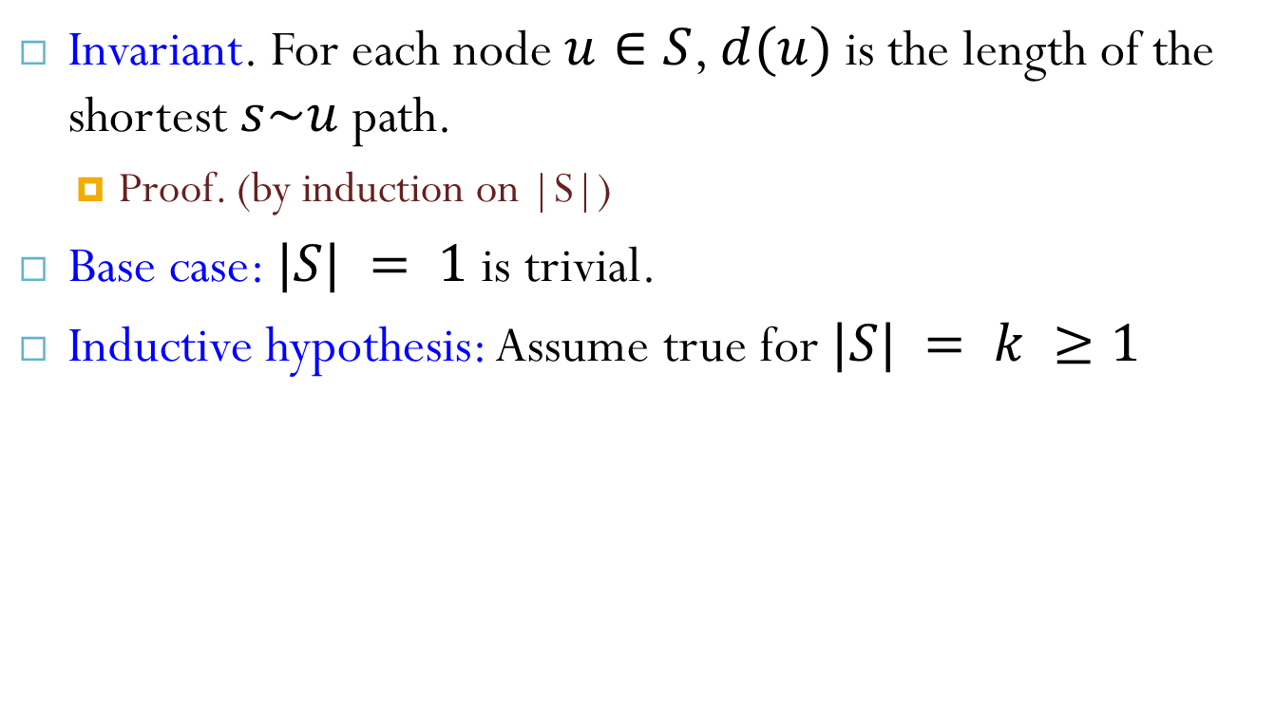
Dijkstra's Algorithm: Proof of Correctness
Invariant. For each node $u∈S$, $d(u)$ is the length of the shortest $s\sim u$ path.
Proof. (by induction on |S|)
Base case: $|S| = 1$is trivial.
Inductive hypothesis: Assume true for $|S| = k ≥1$

Slide 22
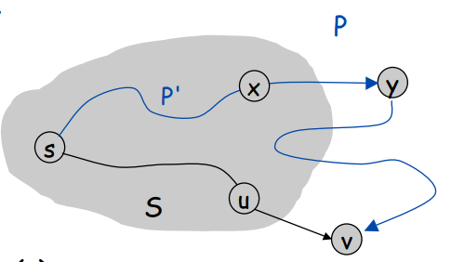
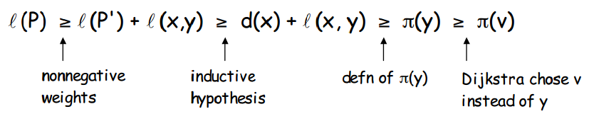
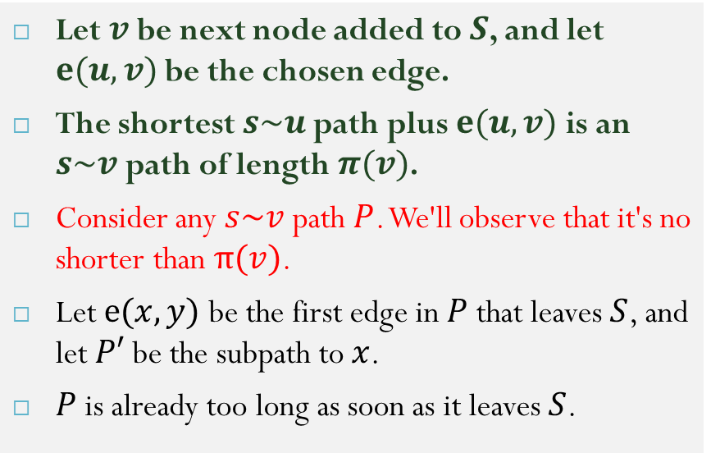
Dijkstra's Algorithm: Proof of Correctness
Let $v$ be next node added to $S$, and let $e(u,v)$ be the chosen edge.
The shortest $s\sim u$ path plus $e(u, v)$is an $s\sim v$ path of length $π(v)$.
Consider any $s\sim v$ path $P$. We'll observe that it's no shorter than $π(v)$.
Let $e(x,y)$ be the first edge in $P$that leaves $S$, and let $P′$be the subpath to $x$.
$P$is already too long as soon as it leaves $S$.

Slide 23
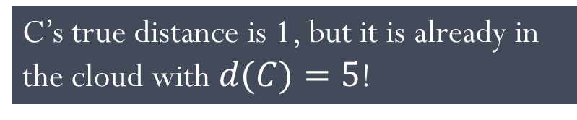
Why It Doesn’t Work for Negative-Weight Edges
Dijkstra’s algorithm is based on the greedy method. It adds vertices by increasing distance.
If a node with a negative incident edge were to be added late to the cloud, it could mess up distances for vertices already in the cloud.
0
8
A
4
6
7
7
5
1
4
B
C
D
5
0
-8
9
2
E
F
5
C’s true distance is 1, but it is already in the cloud with $d(C)=5$!

Slide 24
Shortest Path Properties
Property 1:
A subpath of a shortest path is itself a shortest path
Property 2:
There is a tree of shortest paths from a start vertex to all the other vertices
Example: Tree of shortest paths from Providence
849
PVD
1843
ORD
142
SFO
802
LGA
1743
1205
337
1387
HNL
2555
1099
LAX
1233
DFW
1120
MIA

Slide 25
Reference
Algorithm Design: Foundations, Analysis, and Internet Examples. Michael T. Goodrich and Roberto Tamassia. John Wiley & Sons.
Introduction to Algorithms. Thomas H. Cormen, Charles E. Leiserson, Ronald L. Rivest, Clifford Stein.

Slide 26
Thank you!

